Slide 1
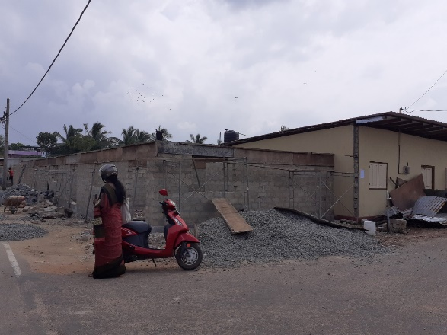
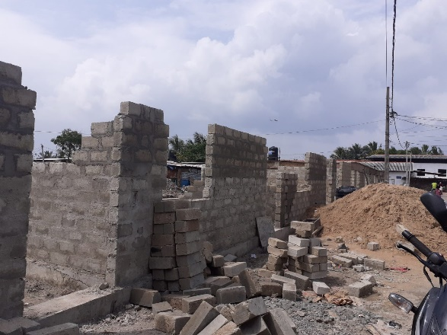
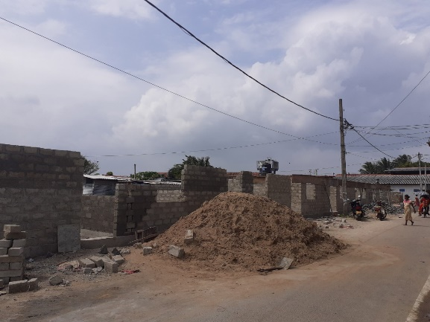
DIVISIONAL SECRETARIAT - JAFFNA
Office for National Unity & Reconciliation
Name of the Programme : Integrated Village Development Project – 2019
ONUR
1. Name of the Project : Construction of Dry Fish Yard at Gurunagar stage II
2. D.S.Division : Jaffna
3. G.N.Division : J/69 Reclamation west
4. Implementing Agency : DS office Jaffna
5. Total Allocation Rs : 10,500,000.00
6. Total Estimate cost Rs : 8,676,000.00
Total Expenditure : -
Name of Contractor : Chella Construction
9. Date of Awarding : 05.09.2019
10. Date of Completion :
11. Physical Progress (%) : 50%
12. No of Beneficiaries : 2000 Person
before the implementation Ongoing

